Slide 1
Source Code Control
Bryan, Kevin, Sameep and Scott
May 22, 2014

Slide 2

Source code control should be extended in MIS with a low-cost, effective solution
MIS source code is federated across multiple systems:
Perforce: Sugar, Salesforce
Subversion: Custom dev
Artifacts that should be version controlled aren’t
Need a lightweight solution
…that is easy for us to use - developer and BSA alike.

Slide 3

Benefits of Standardizing Source Code Control
Streamline deployment process across multiple instances
Automate deployment across non-production instances to support “dot release” QA environments
Single source of the truth
Extend source code control across MIS platforms
Allows for easier restores if necessary
Simplifies multi-user development
Easily maintain different versions of an application

Slide 4
Why not SharePoint?
Not an intended use case
Can’t link changes of multiple files together
Limited diff support
Not developer-friendly
No IDE integration, CLI support

Slide 5
Do you get Git?
“In software development, Git /ɡɪt/ is a distributed revision control and source code management (SCM) system with an emphasis on speed.[4] Git was initially designed and developed by Linus Torvalds for Linux kernel development in 2005.
Every Git working directory is a full-fledged repository with complete history and full version tracking capabilities, not dependent on network access or a central server.
Git is free software distributed under the terms of the GNU General Public License version 2.”
- Wikipedia (http://en.wikipedia.org/wiki/Git_(software))

Slide 6
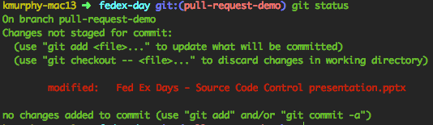
Why Git? Multiple Interaction Modes
Command line

Slide 7
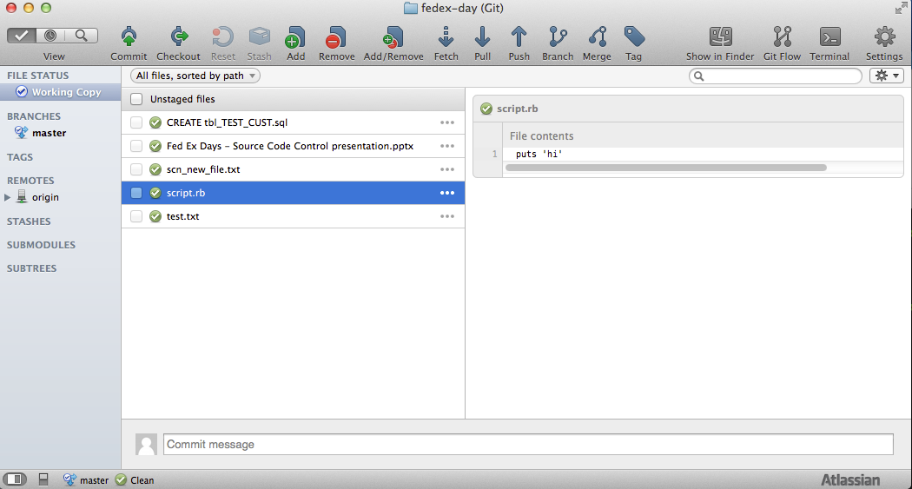
Why Git? Multiple Interaction Modes
Command line
GUI clients

Slide 8
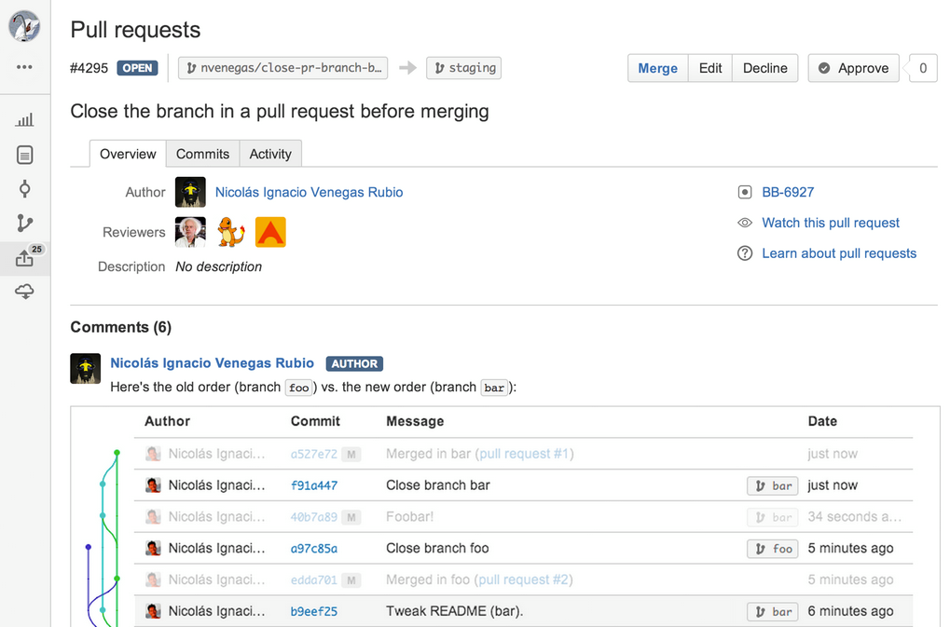
Why Git? Multiple Interaction Modes
Command line
GUI clients
Web interface

Slide 9
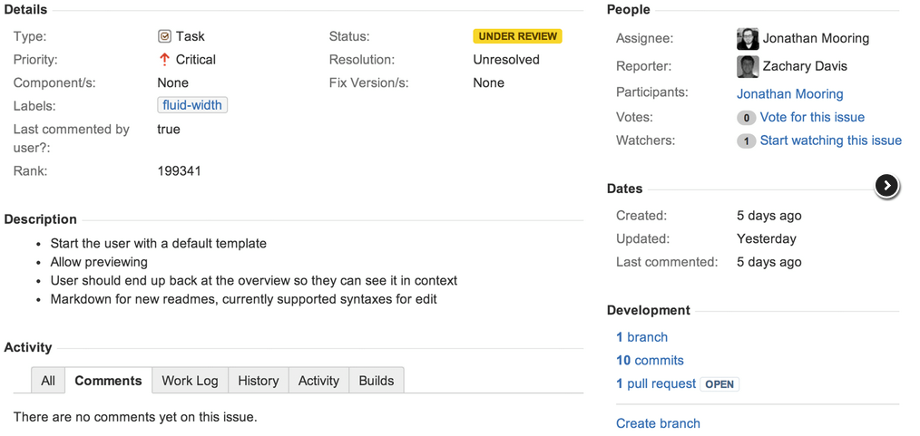
Why Git? Multiple Interaction Modes
Command line
GUI clients
Web interface
JIRA integration

Slide 10
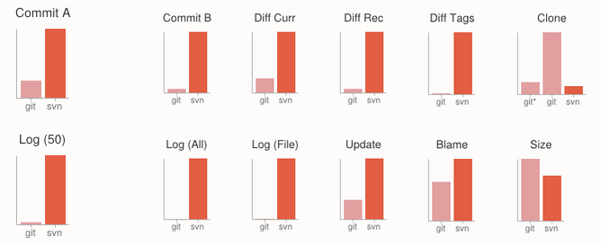
Why Git? Performance
Almost all operations are local

Slide 11
Why Git? Performance
Almost all operations are local
2-step commit process
Commit to local repo
Push local changes to remote

Slide 12
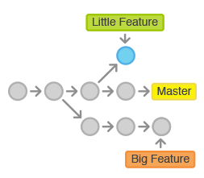
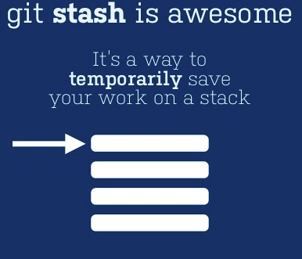
Why Git? Cheap Branching
Safe context-switching
Feature branches
Stash

Slide 13
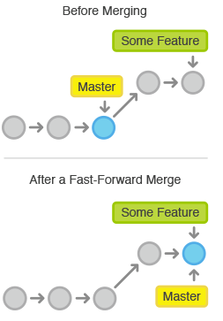
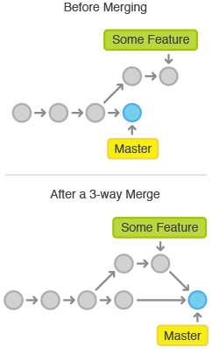
Why Git? Multiple Merge Strategies
Fast Forward
3-way

Slide 14
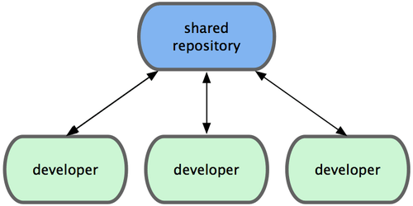
Why Git? Flexible Governance Schemes

Slide 15
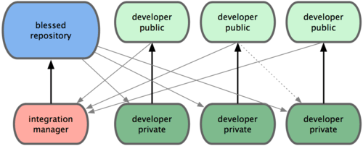
Why Git? Flexible Governance Schemes

Slide 16
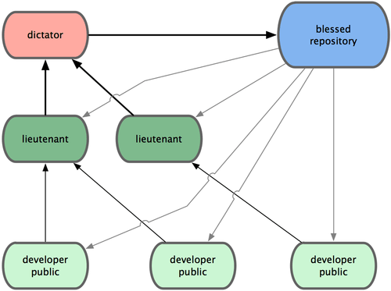
Why Git? Flexible Governance Schemes

Slide 17
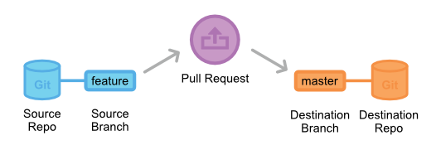
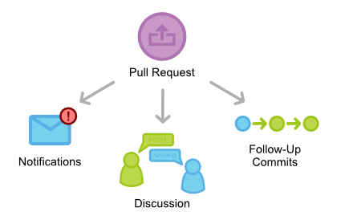
Why Git? Flexible Governance Schemes

Slide 18

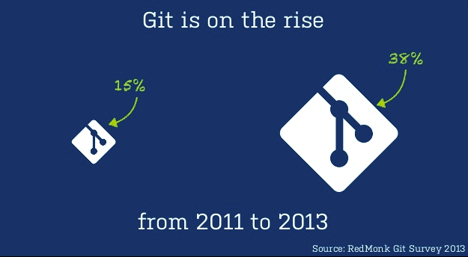
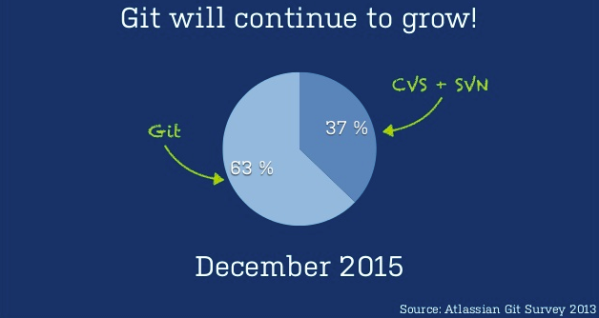
Why Git? Market Adoption

Slide 19
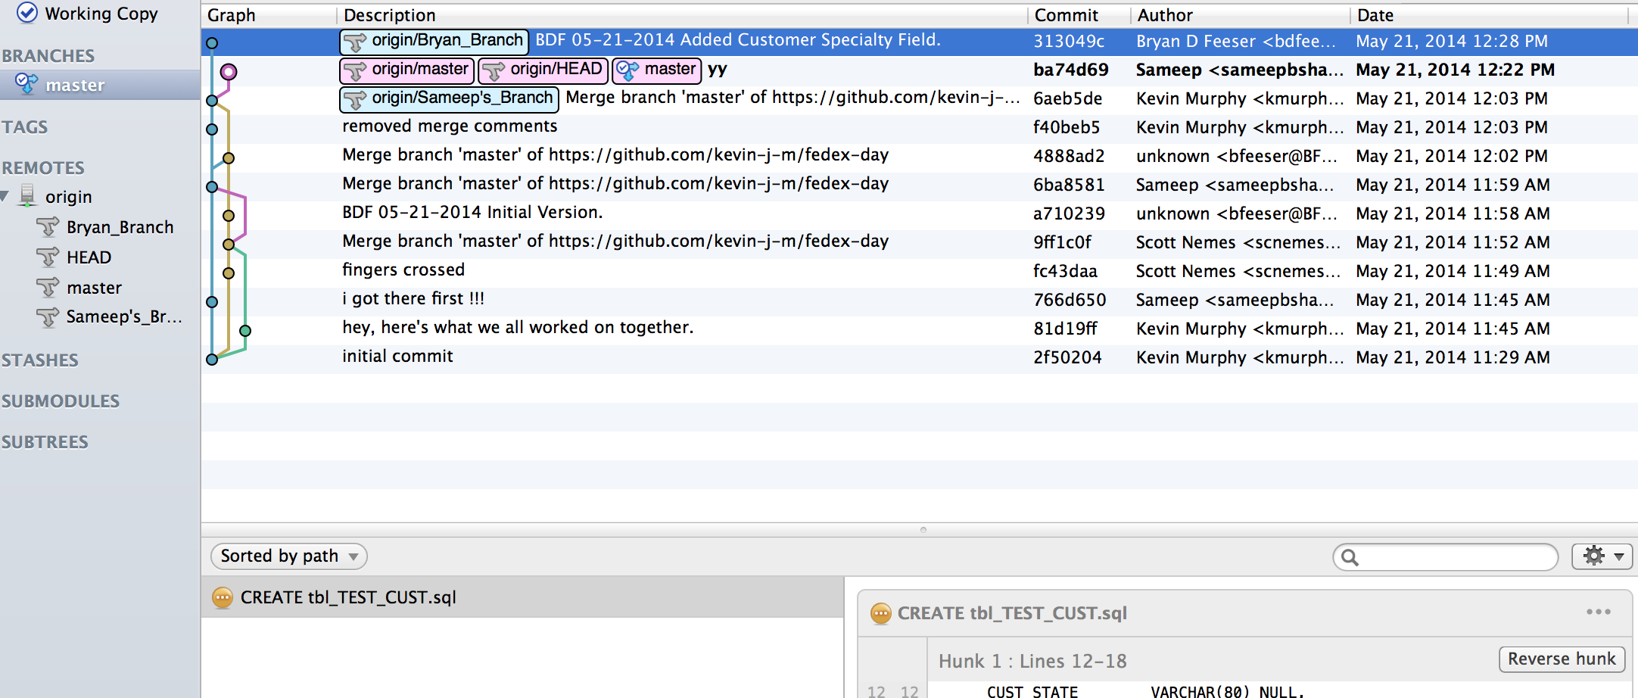
Let’s take a look… demo

Slide 20
Next Steps
Local toolset evaluation
Git server vendor analysis
Cloud
Bitbucket
Github
On Premises
Stash
GitWEb
Migrate
Start with SVN
Fold in Perforce

Slide 21

Word On The Street…
“It’s actually good!”
- As stated on 5/21 in regards to SourceTree

Slide 22

Toolset
Setup GIT environment
http://git-scm.com/
Installs set of git commands to manage repository
Create github repository to share code tree
https://github.com/kevin-j-m/fedex-day
Users need to setup a github account
Git client, an application that facilitates git commands and repository management
http://www.sourcetreeapp.com/download/
This provides a user-friendly interface to take advantage of

Slide 23
Resources
Overview:
http://www.slideshare.net/svenpeters/getting-git-right
http://git-scm.com/about/
Details:
http://git-scm.com/book
https://www.atlassian.com/git/tutorial/git-basics

